Slide 1

WHAT YOU LEARN TODAY
What is Machine Learning Operation (MLOps)
How to apply DevOps Principle in Machine learning Operation
Demo- Implement the basic Machine Model using MLOps Practice

Slide 2
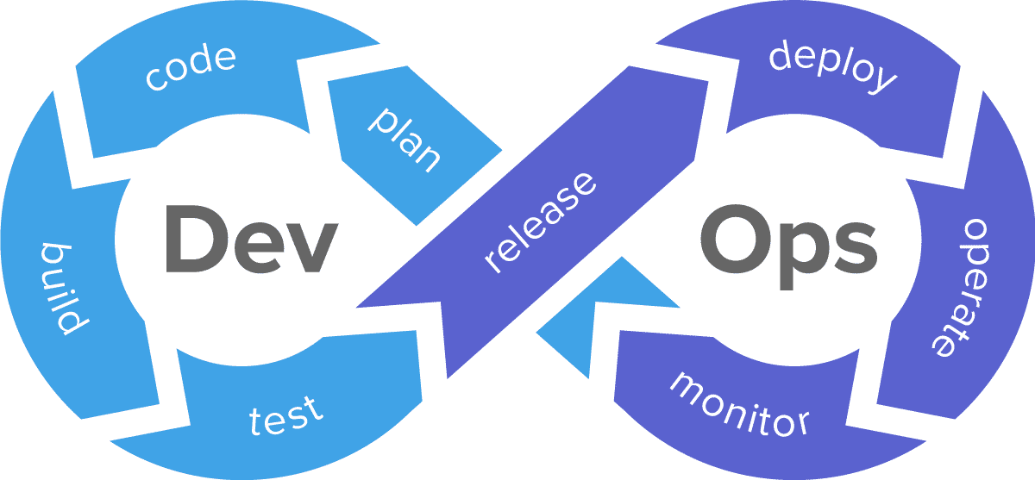
How Many People Seen this Before

Slide 3


DEVOPS PRACTICE
DEVOPS OUTCOMES
Continuous Development
Continuous Code Testing - Quality
Continuous Code Testing - Quality
Faster Product Delivery
Continuous Code Testing - Security
Automation to Improve effeciency
Continuous Integration
Shift Left approach
Continuous Delivery
Quality Deliverable
Continuous Deployment
Greater innovation
Continuous Monitoring
Infrastructure as Code

Slide 4
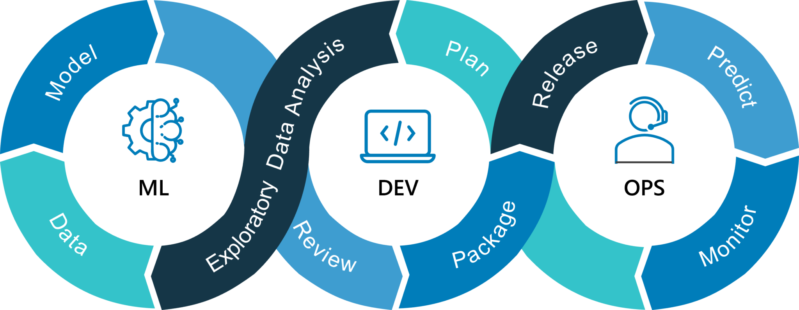
Machine Learning Operation 101

Slide 5
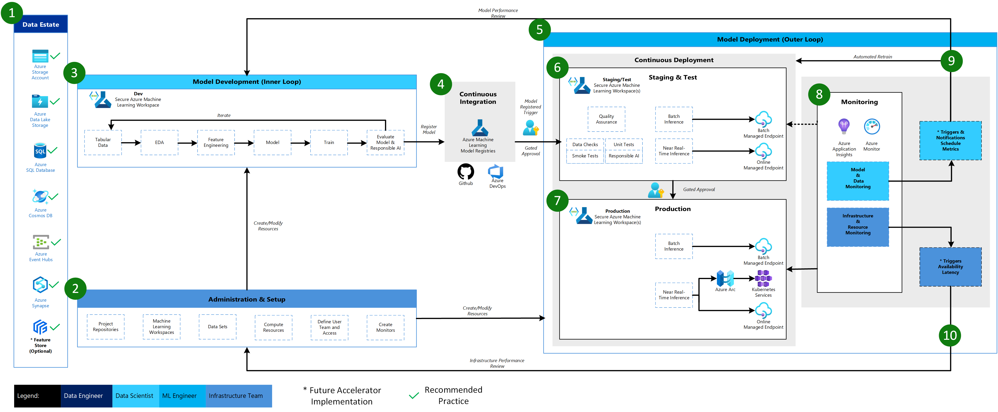
Azure MLOPS Reference Architecture
Ref: https://github.com/Azure/mlops-v2

Slide 6
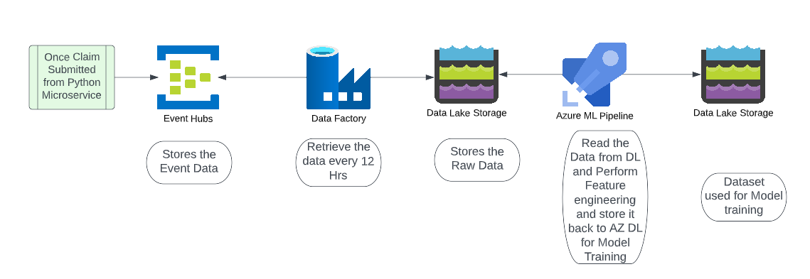
Data Processing

Slide 7
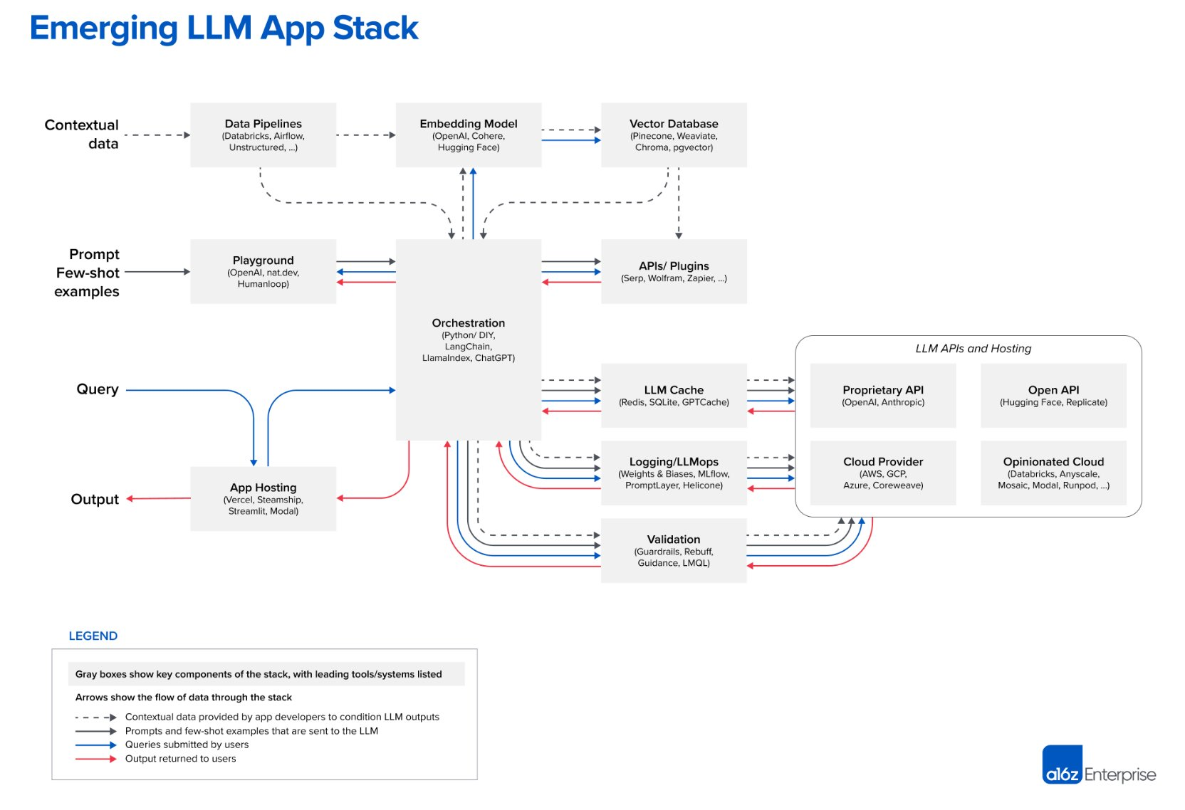
https://cloud.google.com/discover/what-is-llmops?hl=en#what-is-llmops-large-language-model-operations

